Slide 1

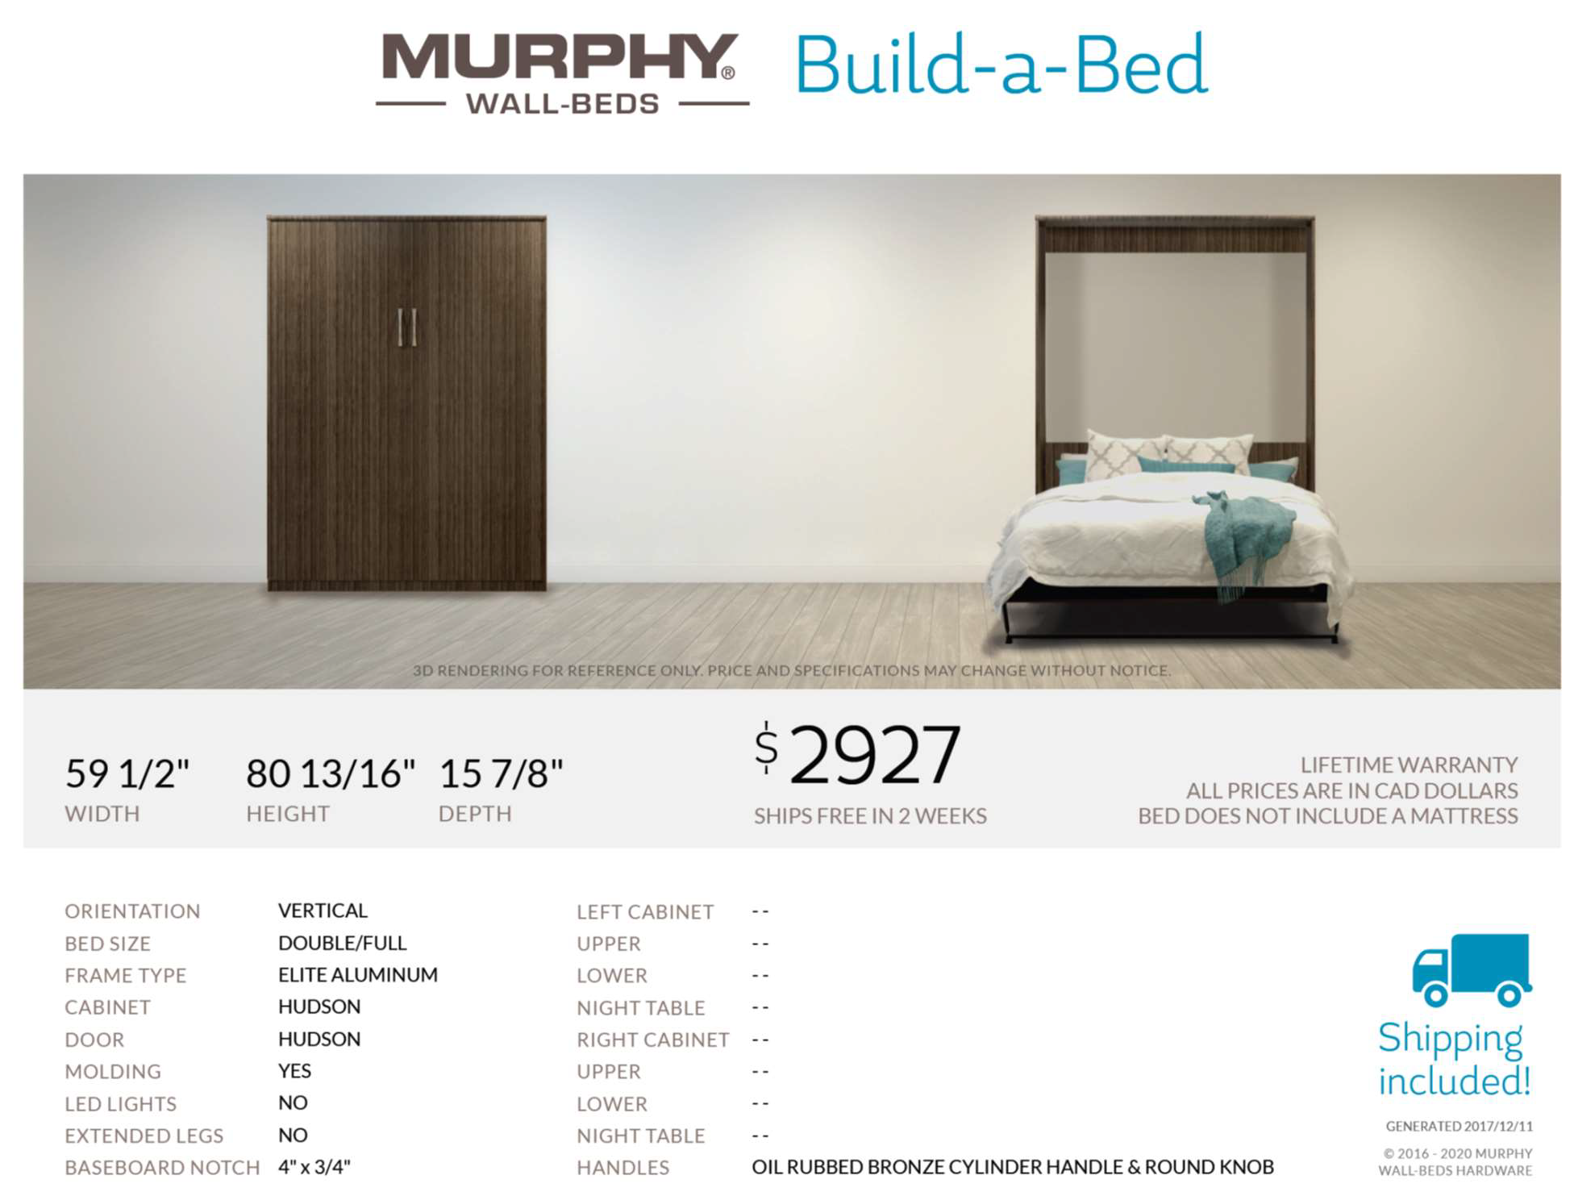
Just in time for Christmas…. Design Extras from Manndate - Versus
Manndate has QTY ‘2’ Double Murphy Beds
(Commercial Mechanism which is much stronger than Residential)
In stock, available in Calgary, for delivery to Versus.
Installation extra – but always available!
The finish is grey. This Murphy Bed is portable, so if you move, you can take it with you. (just touch up wall)
Manndate is offering to Versus residents, @ $1845.
(Retails for $3400)

